Slide 1




















Slide 2
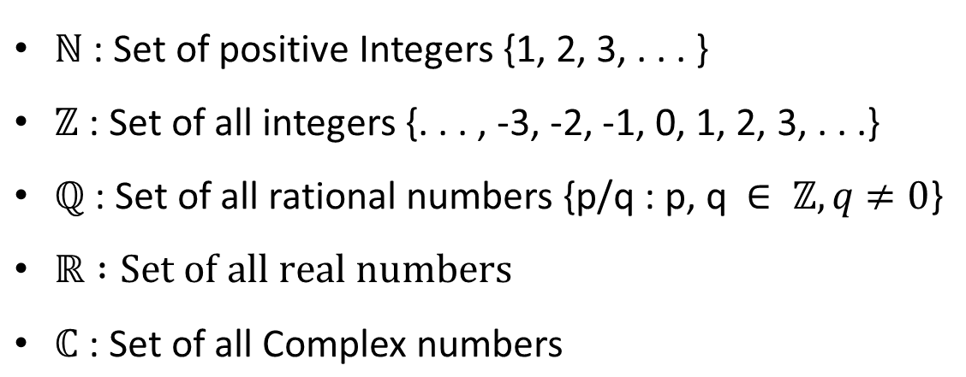

Slide 3

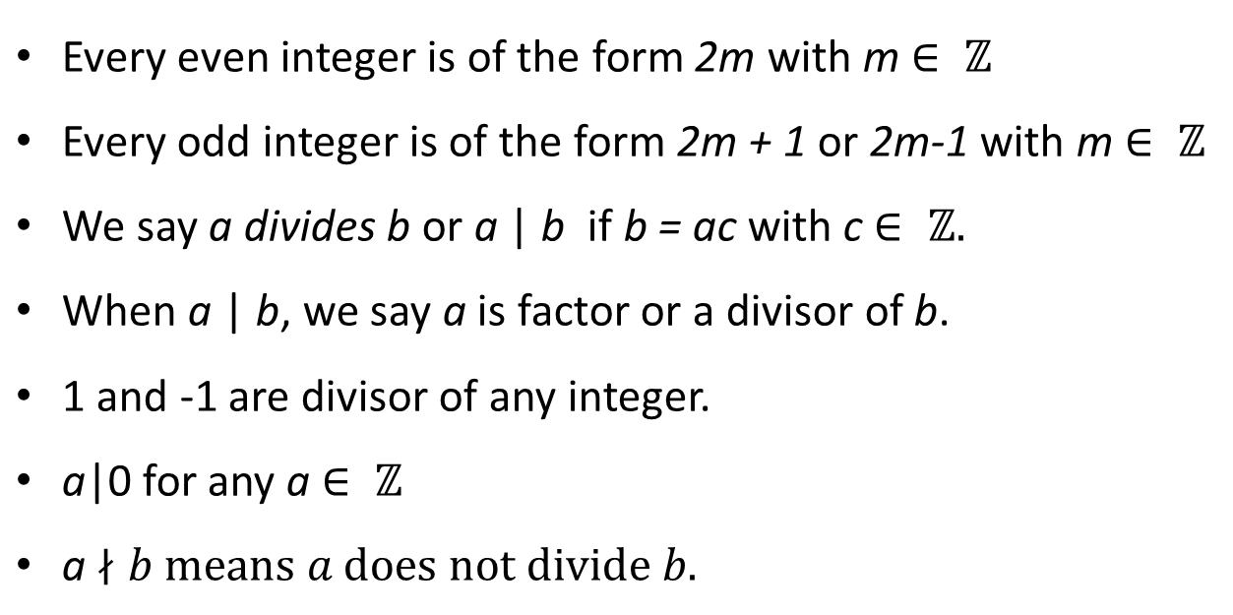

Slide 4





•
•
•
•
•

Slide 5
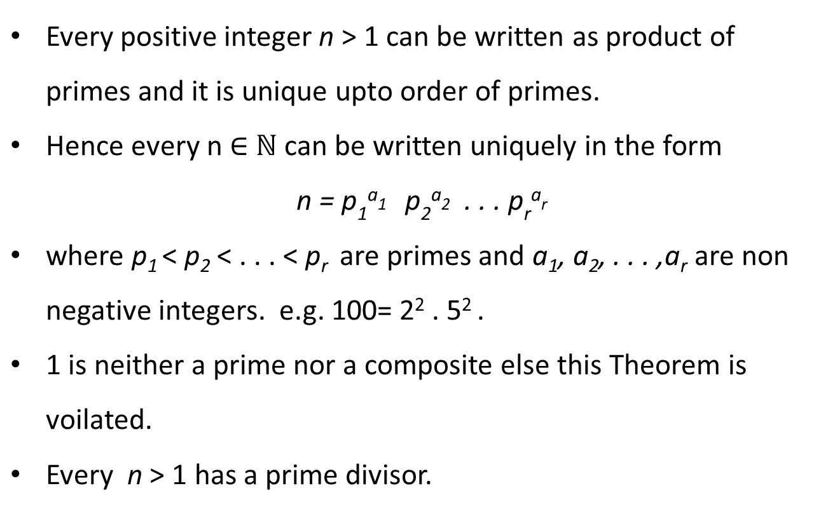

Slide 6
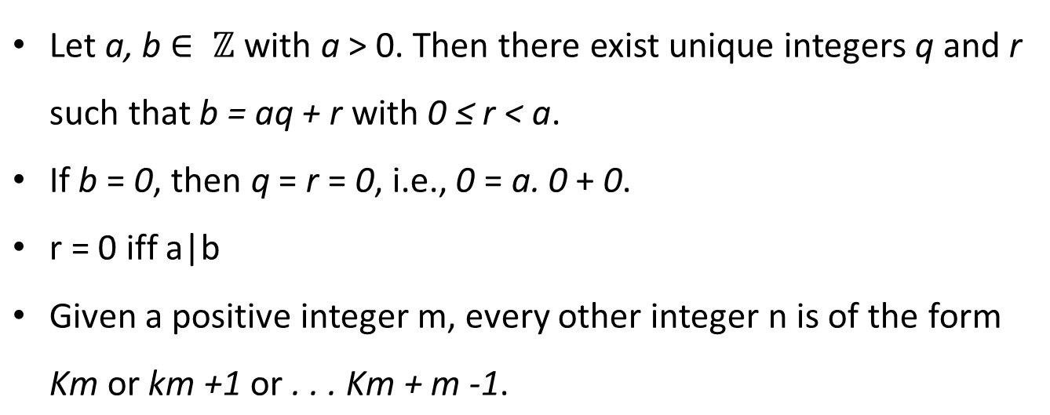
Division theorem and Division algorithms

Slide 7
Division theorem and Division algorithms

Slide 9

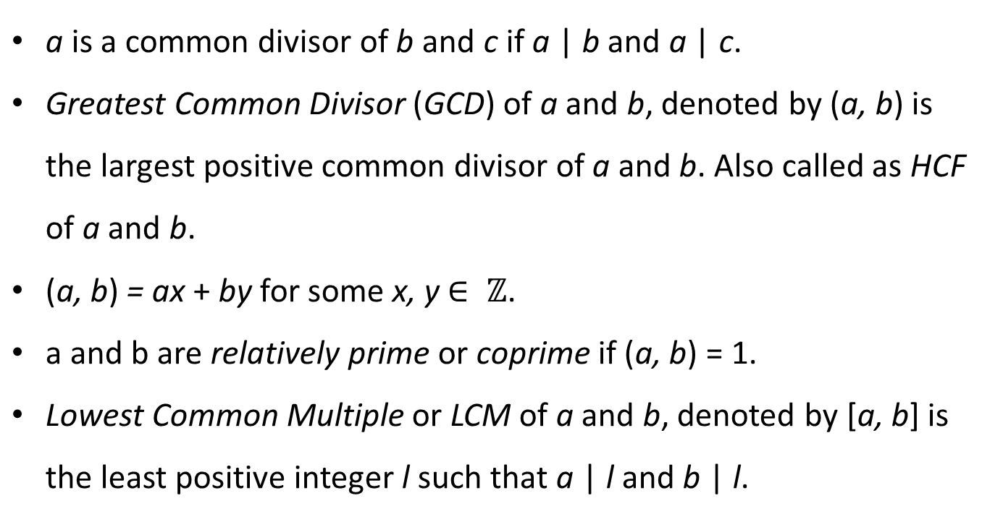

Slide 10
GCD

Slide 11
GCD Algorithm E
GCD(a,b)
Find a/b if remainder is zero then d=gcd(a,b)=b
Otherwise a=b and b=remainder
Repeat above steps till remainder is zero
Why and how it works ?

Slide 12
Euclidean Algorithm
If r₁ is 0 then b|a d=gcd(a,b)=b
If r₁ ≠ 0 then d|r₁ ?
Divisibility theorem
What is that theorem – seen already
Since d|a and d|b shows d|(a-q₁b) this is equal to d|r1
So find gcd(b,r1)

Slide 13


Slide 14














•
•

Slide 15
Extended Euclidean Algorithm

Slide 20
n|(a-b)
(a-b)=kn for some k
a=b+kn
Take modulo both side
(a mod n) = (b mod n) so a≡b(mod n)
n|(a-b) then n|(b-a) b≡a(mod n)
a=b+k1n b= c+k2n then a=c+(k1+k2)n
a=c+Kn
Then a≡c (mod n)

Slide 21
Modular Arithmetic

Slide 22
Example

Slide 28




●
●
●
●

Slide 29





















∈
≡

Slide 30

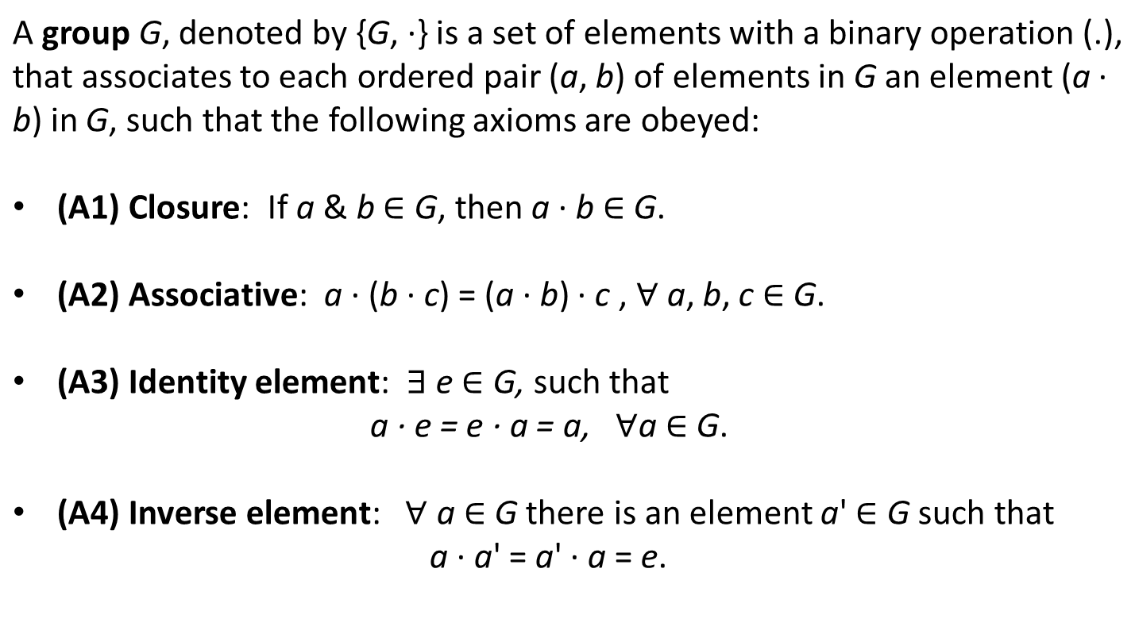

Slide 31

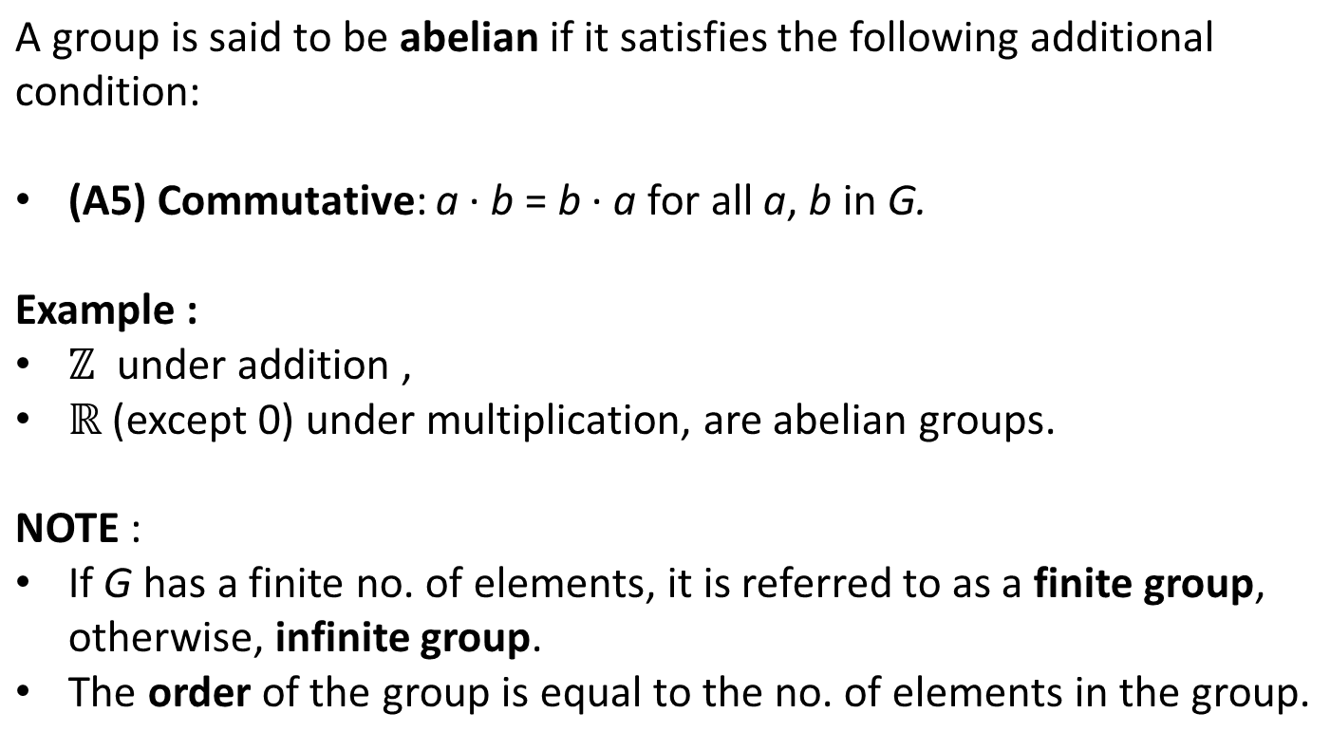

Slide 32

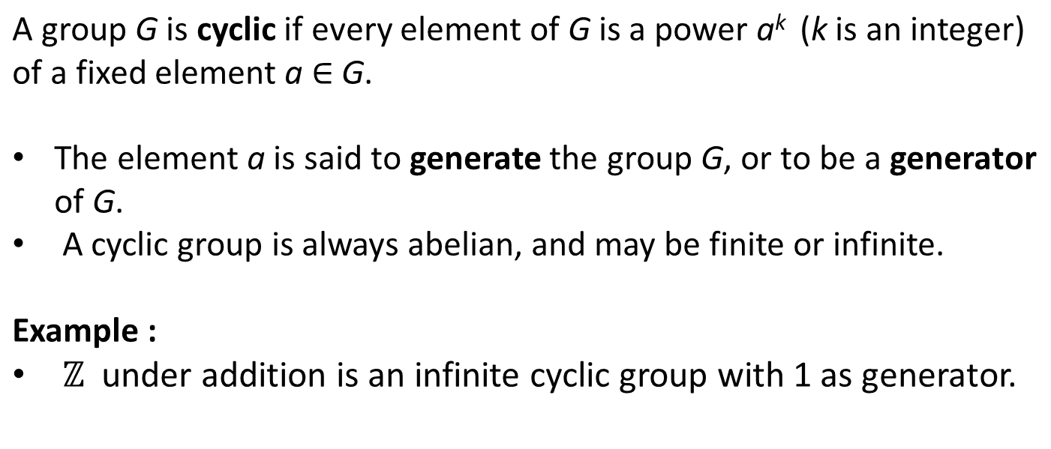

Slide 33

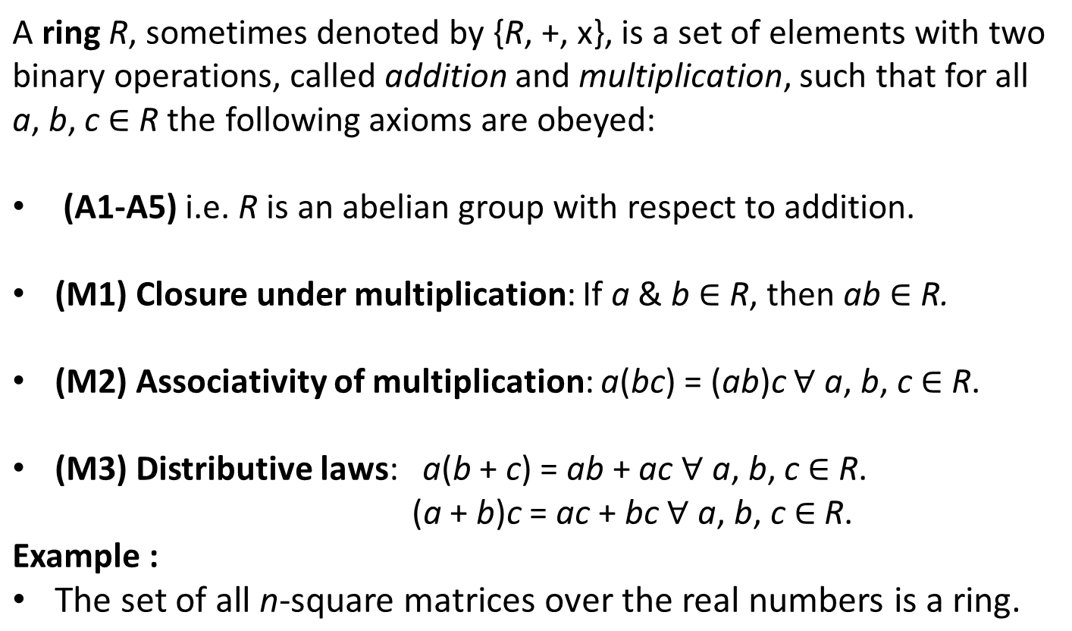

Slide 34

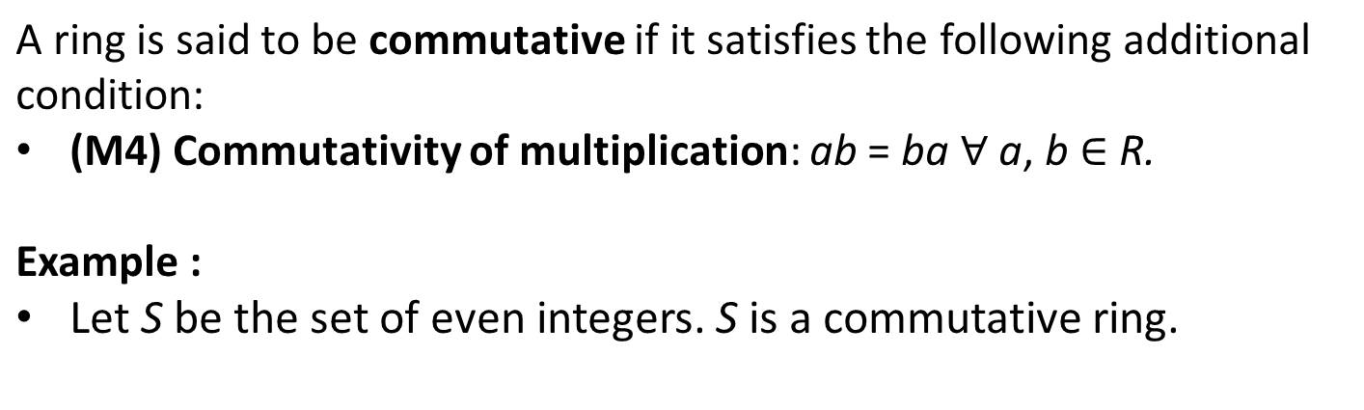

Slide 35

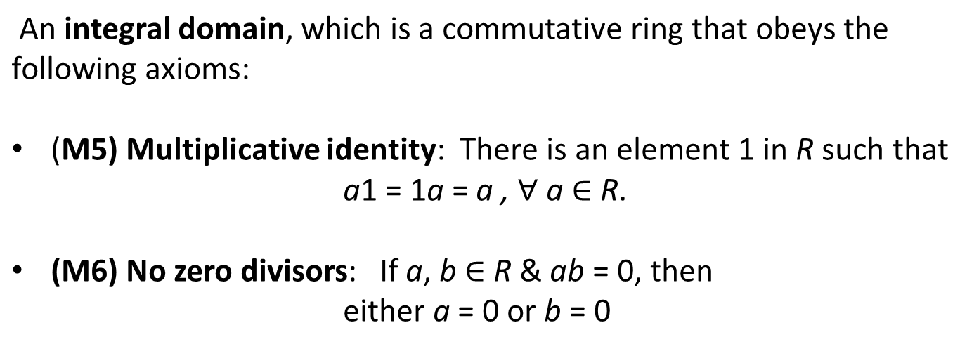
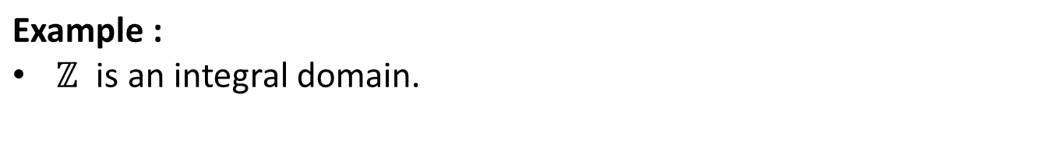

Slide 36

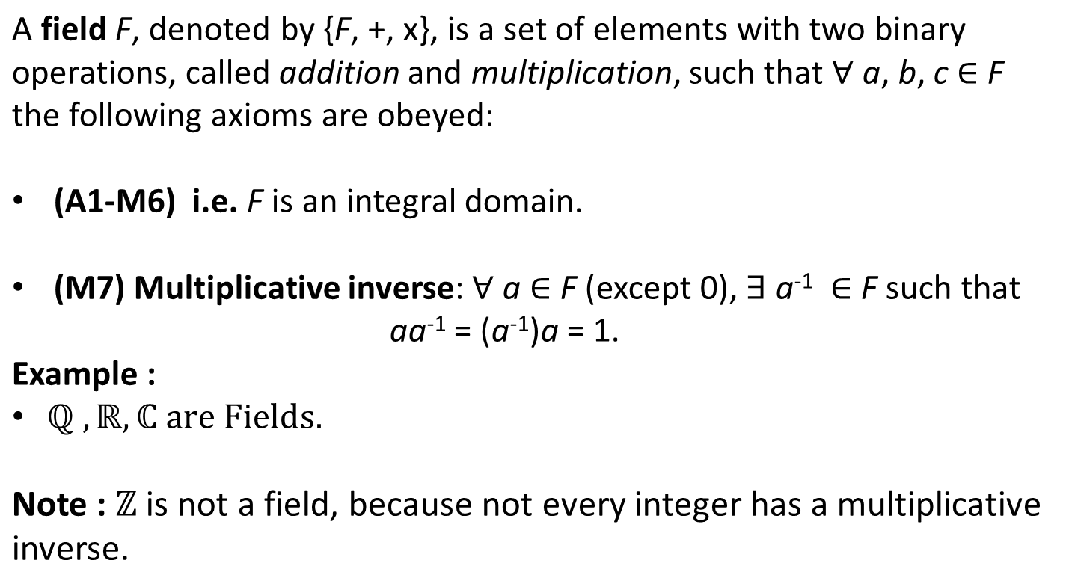

Slide 37
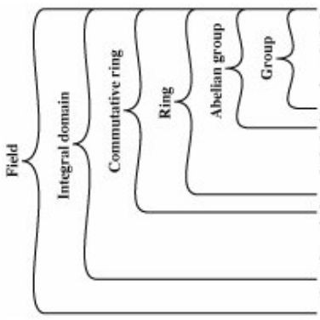
(A1) Closure Under Addition (A2) Associativity Under Addition (A3) Additive Identity
(A4) Additive Inverse
(A5) Commutative under Addition
(M1) Closure Under Multiplication (M2) Associativity Under Multiplication (M3) Distributive Laws
(M4) Commutativity of Multiplication
(M5) Multiplicative Identity (M6) No Zero Division
(M7) Multiplicative Inverse

Slide 38
Arithemtic on polynomials

Slide 39
Ordinary Polynomial Arithmetic TYPE 1

Slide 40
TYPE 1

Slide 41
TYPE 1

Slide 42
TYPE 1
TYPE 2
(RING)
TYPE 3
(FIELD)

Slide 43
TYPE 2
Polynomials are over GF(p) i.e the coefficients are within the range GF(P)
The polynomial operations are performed as TYPE 1 polynomial operations along with the coefficient operations are performed based on modular arithmetic
This set with the above addition and multiplication operations forms a ring

Slide 44
TYPE 2

Slide 45
TYPE 2
TYPE 2

Slide 46
GCD and inverse on TYPE 2 polynomials

Slide 47
DIVISIBILITY

Slide 48
DIVISION THEOREM

Slide 51
Unique Factorization Theorem

Slide 54
TYPE 3 Polynomials
(GF(p^n))

Slide 55
TYPE 3 Polynomials
A set of all polynomials whose coefficient belongs to GF(p) and the degree is lesser than n i.e remainders of a particular irreducible polynomial of degree n and coefficient belongs to GF(p)(TYPE 2 polynomial)
2. Number of elements in this set is p^n when p and n is given
3. This set forms a field

Slide 56
Generating elements in TYPE 3 set
1 TWO ways to generate the set
(i) Enumeration
(ii) using irreducible polynomial
2.First with given p and n simply enumerating all possible combination of p and n
Example
P=2(coefficient) and n=3 (degree)
Then number of elements are 2^3; 8 elements
{0, 1, X, X+1, X^2, X^2+1, X^2+X, X^2+X+1}

Slide 57

●
●

Slide 58









Slide 59

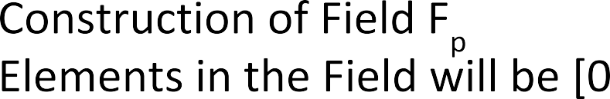
●
…
●
●
●
…

Slide 60


Slide 61















…

Slide 62



m((x)=x^{n}+x+1 ε F_{p}[x]
Where f(x) and g(x) belongs to GF(p^n)

Slide 63
TWO REPRESENTATION of GF(2^n)
Polynomial representation
Binary representation
GF(2³)={0,1,x,x+1, x^2,x^2+1,x^2+x,x^2+x+1}
GF(2³)={000,001,010,011,100,101,110,111}

